Slide 1
Module 1
Introducing Today’s Technologies Computers, Devices, and the web
Copyright © 2018 Cengage Learning®. May not be scanned, copied or duplicated, or posted to a publicly accessible website, in whole or in part.

Slide 2
Objectives Overview (1 of 3)
Differentiate among laptops, tablets, desktops, and servers
Describe the purpose and uses of smartphones, digital cameras, portable and digital media players, e-book readers, wearable devices, and game devices
Describe the relationship between data and information
Briefly explain various input options
Differentiate the web from the Internet, and describe the relationship among the web, webpages, websites, and web servers

Slide 3
Objectives Overview (2 of 3)
Explain the purpose of a browser, a search engine, and an online social network
Briefly describe digital security risks associated with viruses and other malware, privacy, your health, and the environment
Differentiate between an operating system and applications
Differentiate between wired and wireless technologies, and identify reasons individuals and businesses use networks

Slide 4
Objectives Overview (3 of 3)
Discuss how society uses technology in education, government, finance, retail, entertainment, health care, science, travel, publishing, and manufacturing
Identify technology used by home users, small/home office users, mobile users, power users, and enterprise users

Slide 5
Today’s Technology (1 of 2)
Because technology changes, you must keep up with the changes to remain digitally literate
Digital literacy involves having a current knowledge and understanding of computers, mobile devices, the web, and related technologies

Slide 6
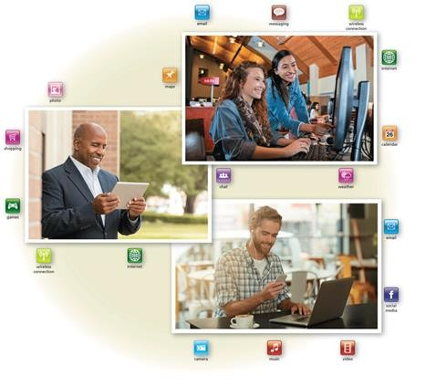
Today’s Technology (2 of 2)
Figure 1-1 People use a variety of computers, mobile devices, and apps every day.

Slide 7
Computers (1 of 5)
A computer is an electronic device, operating under the control of instructions stored in its own memory
Collects data (input)
Processing
Produces information (output)
Information Processing Cycle

Slide 8
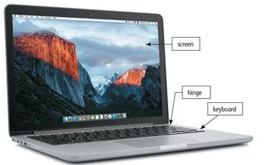
Computers (2 of 5)
Laptop/Notebook computers
Small portable computers
Weighs between 3 and 8 pounds
About 8 ½ by 11 inches
Typically as powerful as a desktop
Can include a docking station
Figure 1-2 A laptop is a widely used type of computer.

Slide 9
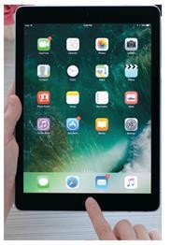
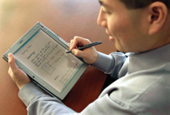
Computers (3 of 5)
Tablet computers
Newest development in portable computers
Input is through a pen
Run specialized versions of office products
Figure 1-3 A slate tablet.

Slide 10
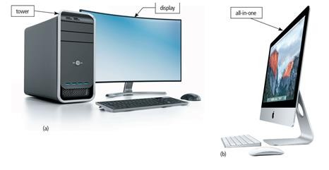
Computers (4 of 5)
Desktop and All-in-One
Figure 1-4 Some desktops have a separate tower; all-in-ones do not.

Slide 11
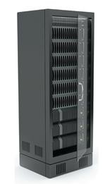
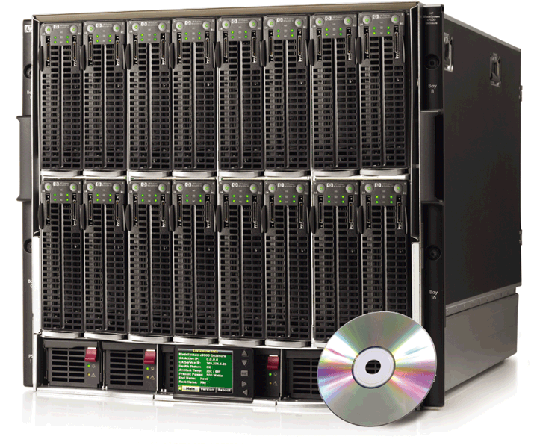
Computers (5 of 5)
A server controls access to the hardware, software, and other resources on a network
Provides a centralized storage area for programs, data, and information

Slide 12
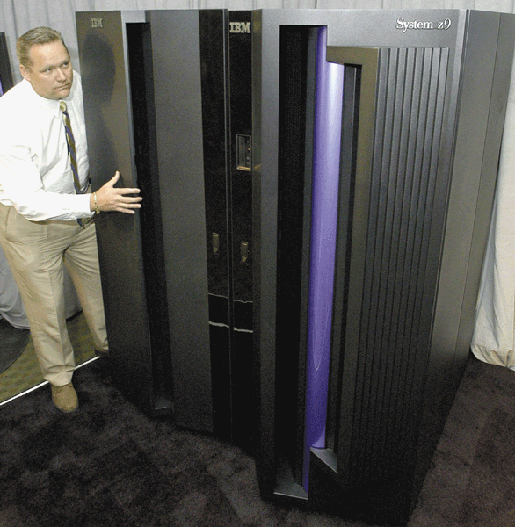
Mainframes
A mainframe is a large, expensive, powerful computer that can handle hundreds or thousands of connected users simultaneously

Slide 13
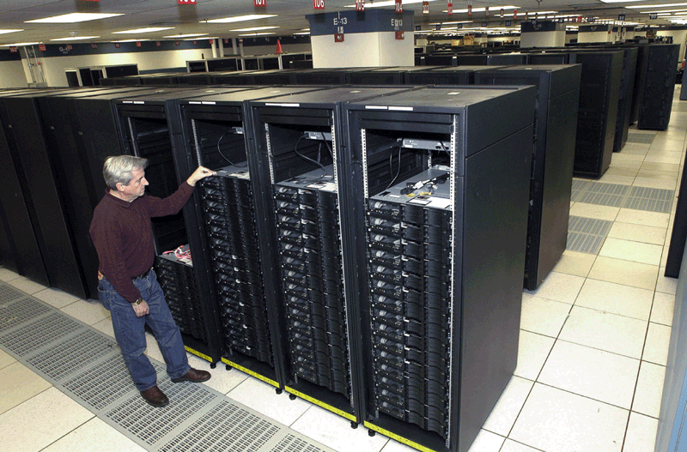
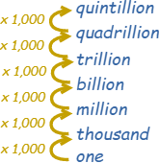
Supercomputers
A supercomputer is the fastest, most powerful computer
Fastest supercomputers are capable of processing more than one quadrillion instructions in a single second

Slide 14
Embedded Computers
An embedded computer is a special-purpose computer that functions as a component in a larger product
Consumer Electronics
Home Automation Devices
Automobiles
Process Controllers and Robotics
Computer Devices and Office Machines
Mobile and digital telephones
Digital televisions
Cameras
Video recorders
DVD players and recorders
Answering machines
Thermostats
Sprinkling systems
Security monitoring systems
Appliances
Lights
Antilock brakes
Engine control modules
Airbag controller
Cruise control
Remote monitoring systems
Power monitors
Machine controllers
Medical devices
Keyboards
Printers
Faxes
Copiers

Slide 15
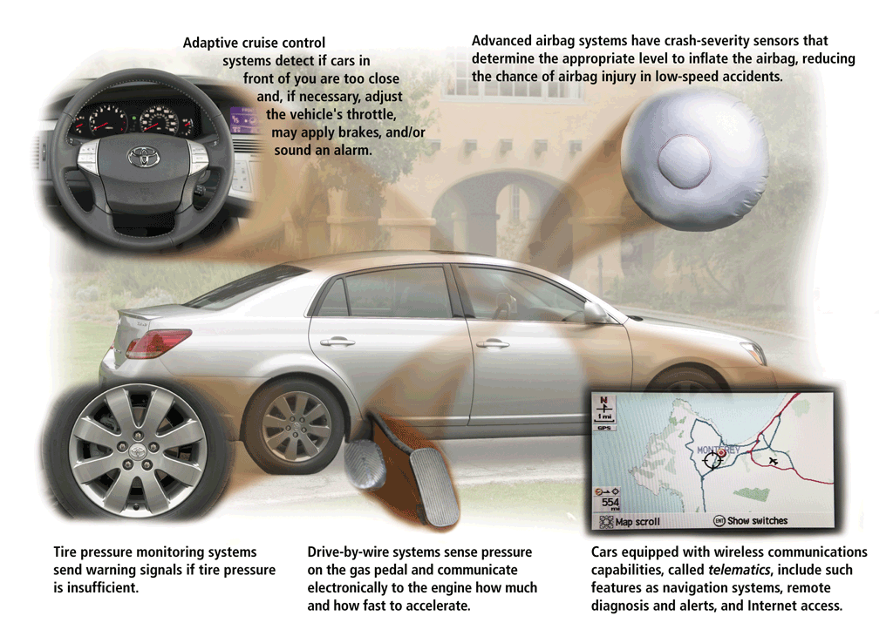

Slide 16
Mobile and Game Devices
Smartphone
Digital camera
Portable and digital media player
E-book reader
Wearable device
Game device

Slide 17
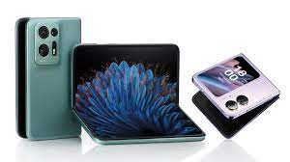
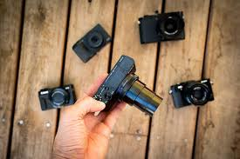
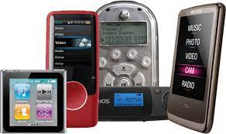
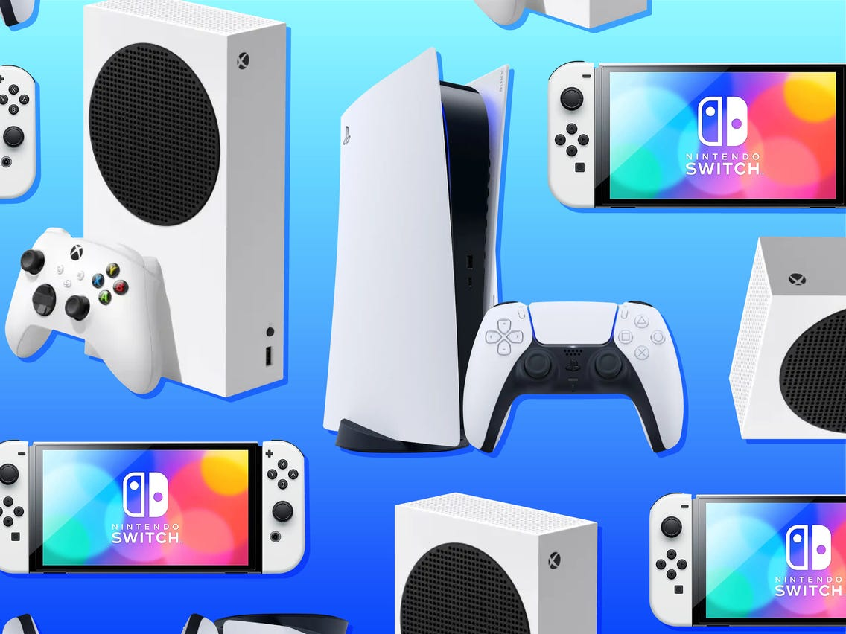
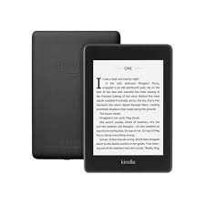
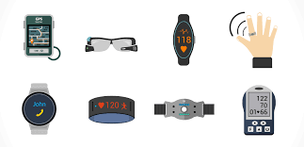

Slide 18
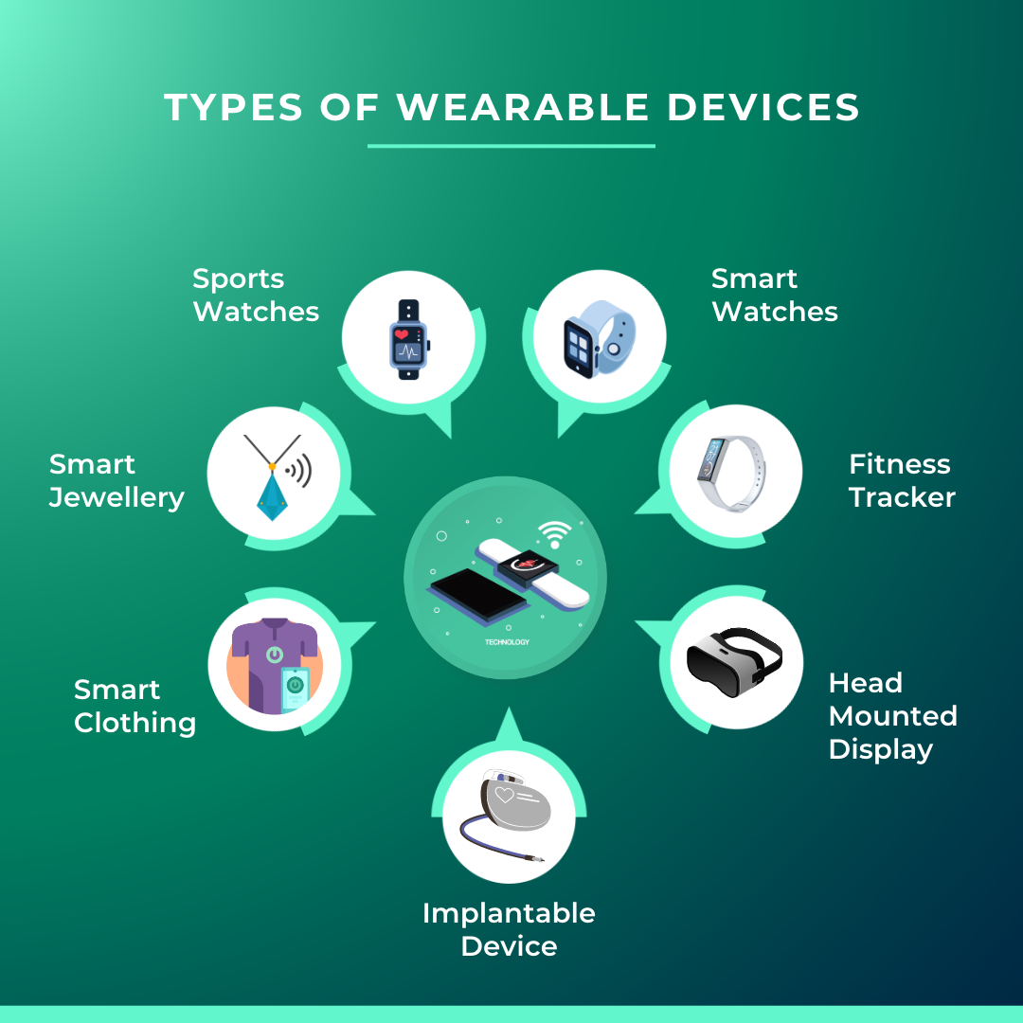

Slide 19
The Components of a Computer
The Components of a Computer
The Components of a Computer
A computer contains many electric, electronic, and mechanical components known as hardware
Input Device
Output Device
System Unit
Storage Device
Communications Device
Allows you to enter data and instructions into a computer
Hardware component that conveys information to one or more people
Case that contains the electronic components of the computer that are used to process data
Records (writes) and/or retrieves (reads) items to and from storage media
Enables a computer to send and receive data, instructions, and information to and from one or more computers or mobile devices

Slide 20
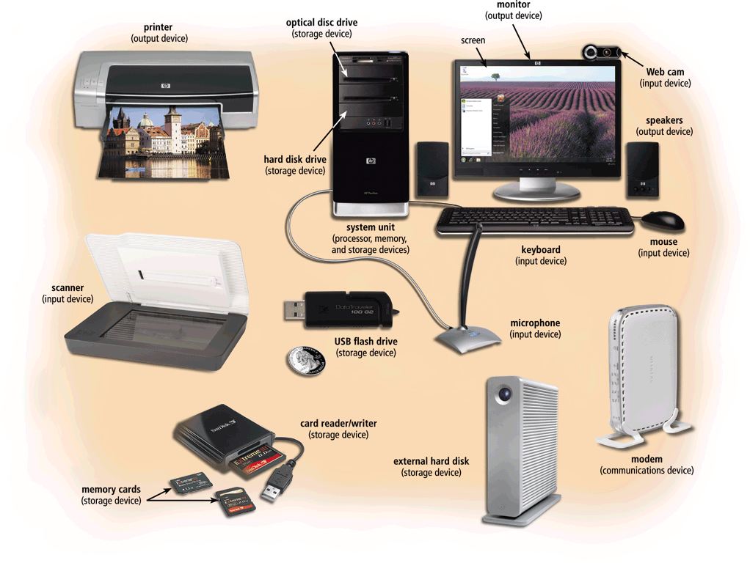

Slide 21
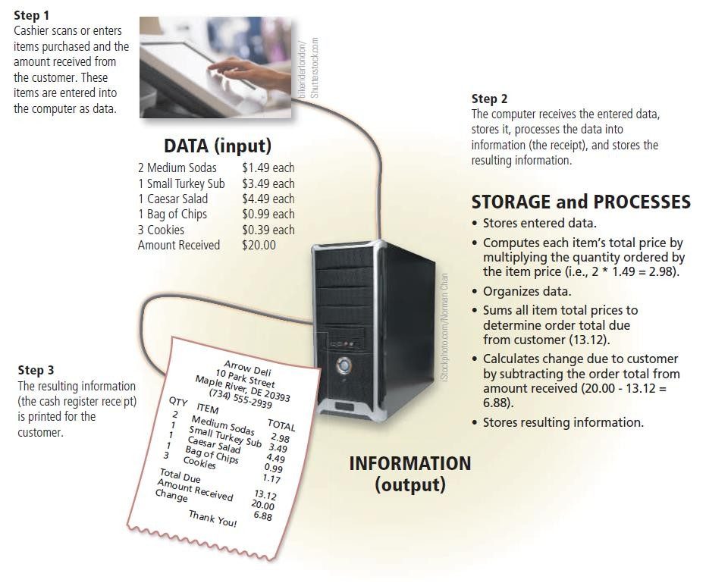
Data and Information (1 of 14)
Figure 1-12 A computer processes data into information. In this simplified example, the item ordered, item price, quantity ordered, and amount received all represent data (input). The computer processes the data to produce the cash register receipt (information, or output).

Slide 22
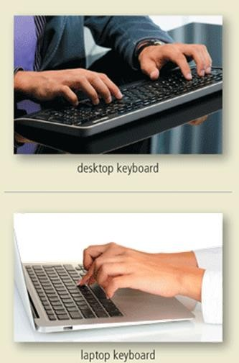
Data and Information (2 of 14)
A keyboard contains keys you press to enter data and instructions into a computer or mobile device

Slide 23
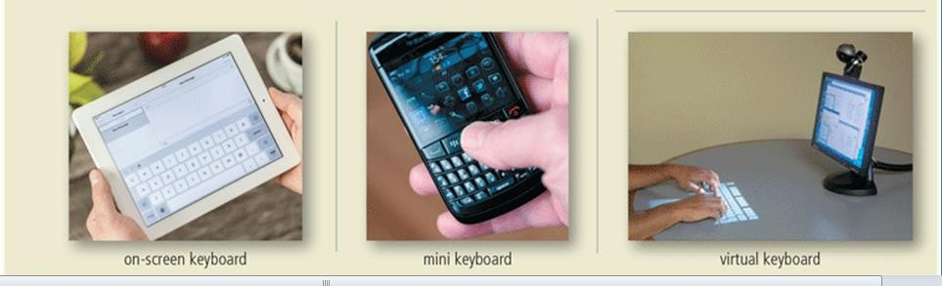
Data and Information (3 of 14)
Figure 1-13 Users have a variety of options for entering typed text.

Slide 24
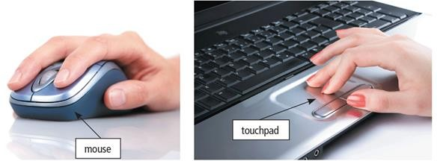
Data and Information (4 of 14)
A pointing device is an input device that allows a user to control a small symbol on a screen, called the pointer
Some mobile devices and computers enable you to speak data instructions using voice input and to capture live full-motion images using video input
Figure 1-14 A mouse and a touchpad.

Slide 25
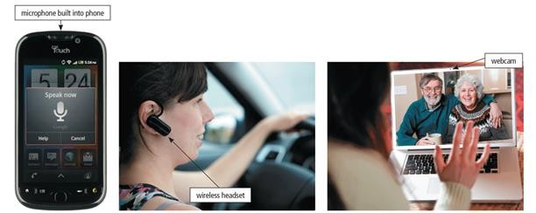
Data and Information (5 of 14)
Figure 1-15 You can speak instructions into a microphone or wireless headset and capture live video on a webcam for a video call.

Slide 26
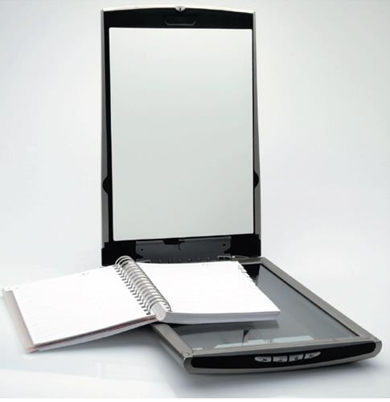
Data and Information (6 of 14)
A scanner is a light-sensing input device that converts printed text and images into a form the computer can process
Figure 1-16 A Scanner.

Slide 27
Data and Information (7 of 14)
An output device is any hardware component that conveys information from a computer or mobile device to one or more people
A printer is an output device that produces text and graphics on a physical medium, such as paper or other material
– A 3-D printer can print solid objects, such as clothing, prosthetics, eyewear, implants, toys, parts, prototypes, and more

Slide 28
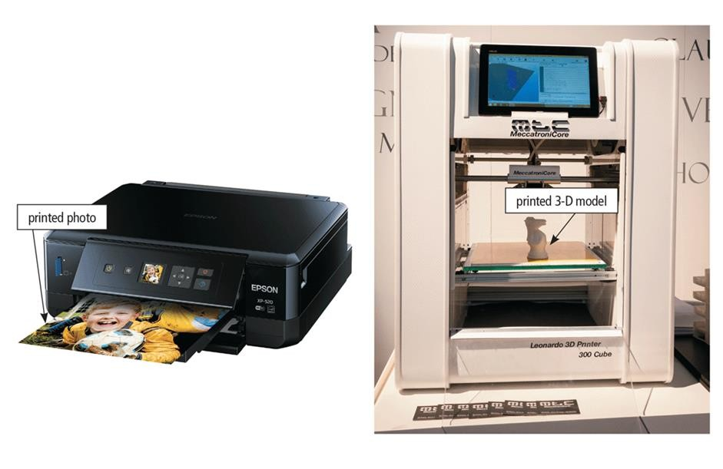
Data and Information (8 of 14)
Figure 1-17 A printer can produce a variety of printed output including photos and 3-D solid objects.

Slide 29
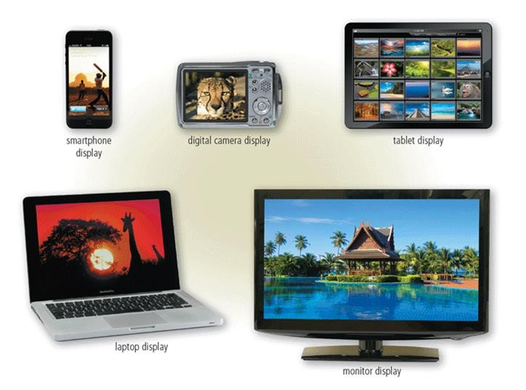
Data and Information (9 of 14)
A display is an output device that visually conveys text, graphics, and video information
Figure 1-18 Displays vary depending on the computer or mobile device.

Slide 30
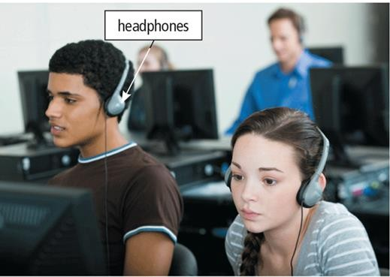
Data and Information (10 of 14)
Speakers allow you to hear audio such as music, voice, and other sounds
Earbuds
Headphones
Figure 1-19 In a crowded environment where speakers are not practical, users can wear headphones to hear music, voice, and other audio.

Slide 31
Data and Information (11 of 14)
Memory consists of electronic components that store instructions waiting to be executed and the data needed by those instructions
A computer keeps data, instructions, and information on storage media
A storage device records (writes) and/or retrieves (reads) items to and from storage media

Slide 32
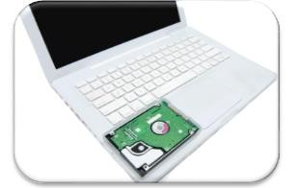
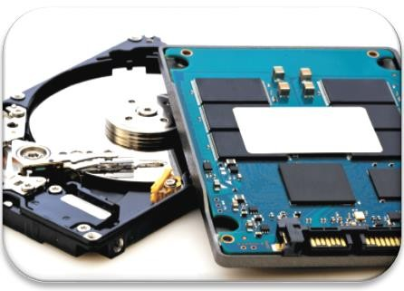
Data and Information (12 of 14)
Hard Disk
Solid-State Drive

Slide 33
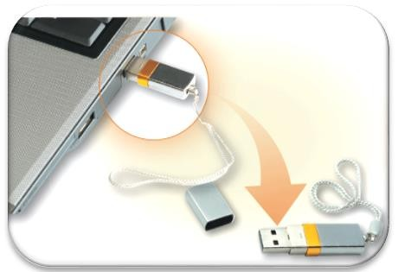
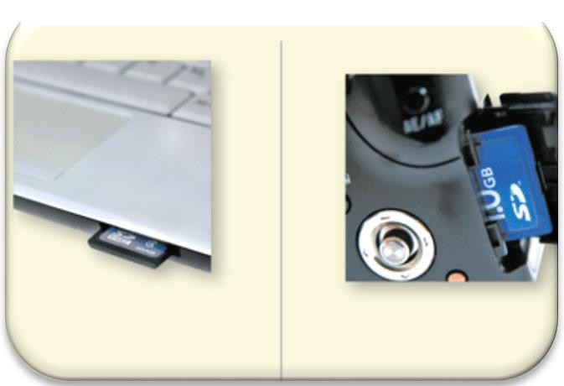
Data and Information (13 of 14)
USB Flash Drive
Memory Card

Slide 34
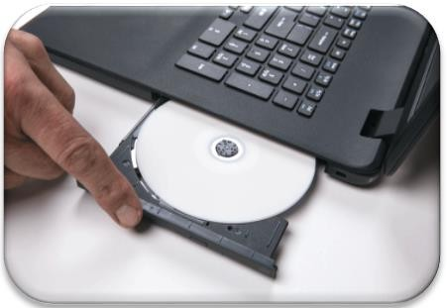
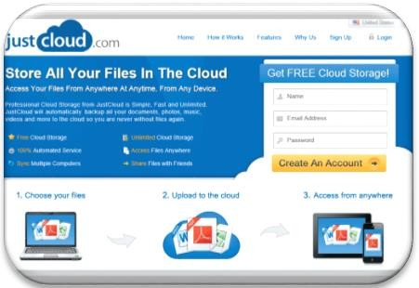
Data and Information (14 of 14)
Optical Disc
Cloud Storage

Slide 35
The Web (1 of 8)
The Internet is a worldwide collection of computer networks that connects millions of businesses, government agencies, educational institutions, and individual

Slide 36
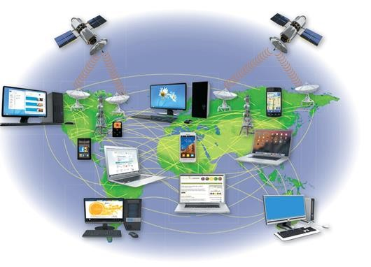
The Web (2 of 8)
Figure 1-27 The Internet is the largest computer network, connecting millions of computers and devices around the world.

Slide 37
The Web (3 of 8)
The World Wide Web (or web, for short) is a global library of information available to anyone connected to the Internet
The web consists of a worldwide collection of electronic documents, each of which is called a webpage
A website is a collection of related webpages
A web server is a computer that delivers requested webpages to your computer or mobile device

Slide 38
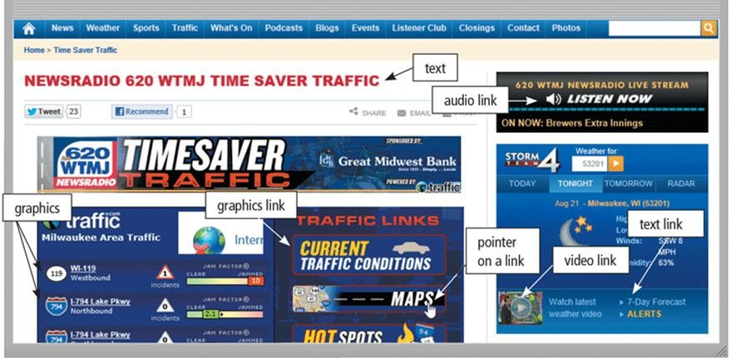
The Web (4 of 8)
Figure 1-28 Webpages, such as the one shown here, can display text, graphics, audio, and video on a computer or mobile device. Pointing to a link on the screen typically changes the shape of the pointer to a small hand with a pointing index finger.

Slide 39
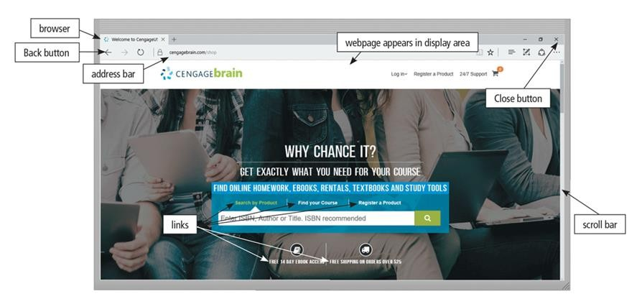
The Web (5 of 8)
A browser is software that enables users with an Internet connection to access and view webpages on a computer or mobile device

Slide 40
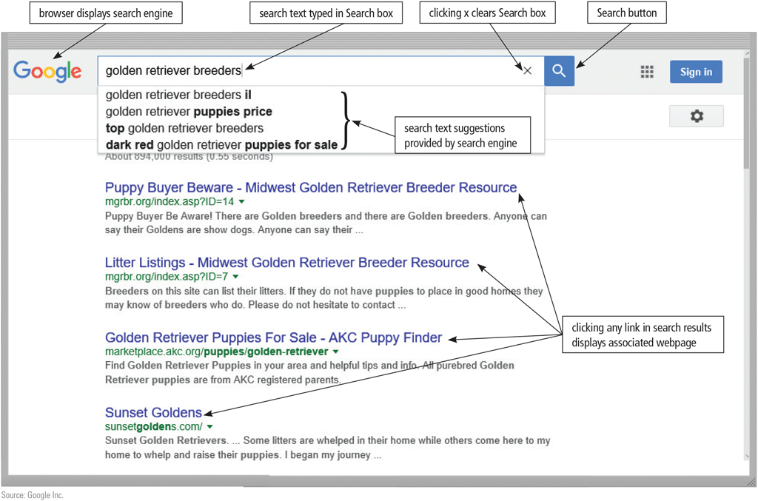
The Web (6 of 8)
A search engine is software that finds websites, webpages, images, videos, news, maps, and other information related to a specific topic

Slide 41
The Web (7 of 8)
An online social network, also called a social networking site, is a website that encourages members in its online community to share their interests, ideas, stories, photos, music, and videos with other registered users

Slide 42
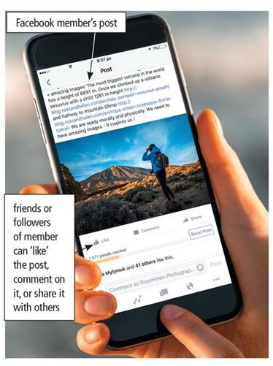
The Web (8 of 8)
Figure 1-29 When Facebook users share, comment on, or “like” a post, the post
appears on their own personal Facebook pages.

Slide 43
Digital Safety and Security (1 of 2)
It is important that users protect their computers and mobile devices
Viruses and Other Malware
Privacy
Health Concerns
Environmental Issues

Slide 44
Digital Safety and Security (2 of 2)
Green computing involves reducing the electricity consumed and environmental waste generated when using a computer
Strategies include:
Recycling
Using energy efficient hardware and energy saving features
Regulating manufacturing processes
Extending the life of computers
Immediately donating or properly disposing of replaced computers

Slide 45
Programs and Apps (1 of 6)
Software, also called a program, tells the computer what tasks to perform and how to perform them
– System Software
Operating system
Tools

Slide 46
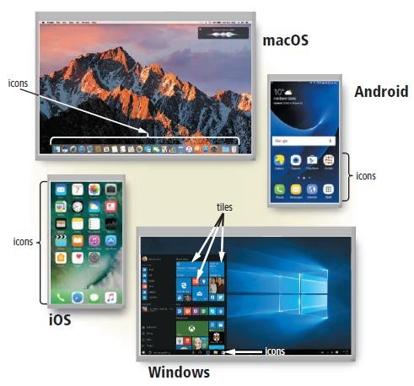
Programs and Apps (2 of 6)
Figure 1-30 Shown here are the macOS and Windows operating systems for laptops and desktops and the Android and iOS operating systems for smartphones. You interact with these operating system interfaces by clicking or tapping their icons or tiles.

Slide 47
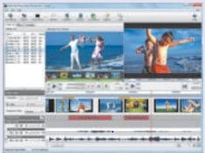
Programs and Apps (3 of 6)
– Applications

Slide 48
Programs and Apps (4 of 6)
Installing a program is the process of setting up the program to work with a computer or mobile device, printer, and/or other hardware
Once installed, you can run a program so that you can interact with it
You interact with a program through its user interface

Slide 49
Programs and Apps (5 of 6)
A software developer, sometimes called a developer or programmer, is someone who develops programs and apps or writes the instructions that direct the computer or mobile device to process data into information

Slide 50
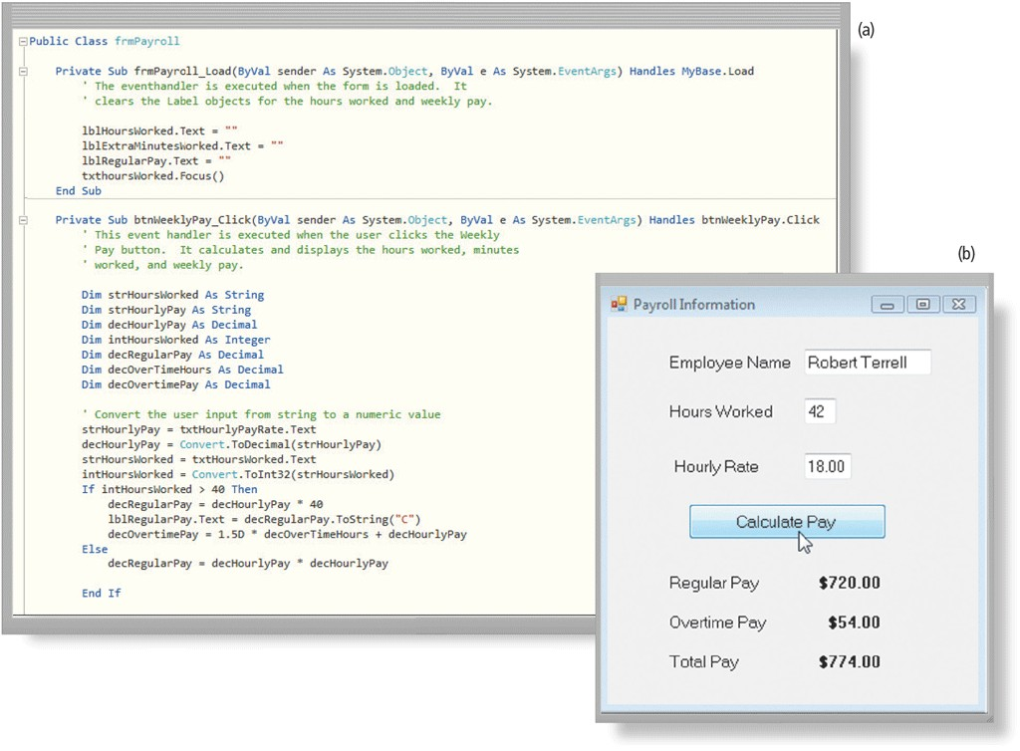
Programs and Apps (6 of 6)
Figure 1-31 A software developer writes instructions using Visual Basic (a) to create Payroll Information window shown here (b).

Slide 51
Communications and Networks (1 of 7)
In the course of a day, it is likely you use, or use information generated by, one or more of these communications technologies
Chat rooms
Email
Fax
FTP
GPS

Slide 52
Communications and Networks (2 of 8)
Instant messaging
Internet
Newsgroups
RSS
Videoconference
Voice mail
VoIP

Slide 53
Communications and Networks (3 of 8)
A communications device is hardware capable of transferring items from computers and devices to transmission media and vice versa

Slide 54
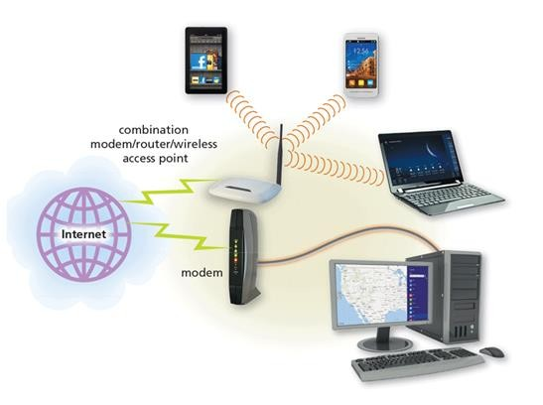
Communications and Networks (4 of 8)
Figure 1-32 Modems, wireless access, and routers are examples of communications devices that enable communications between computers/ mobile devices and the Internet. Notice that some computers and devices communicate via wires, and others communicate wirelessly.

Slide 55
Communications and Networks (5 of 8)
Examples of wireless communications technologies include:
Wi-Fi
Bluetooth
Cellular radio

Slide 56
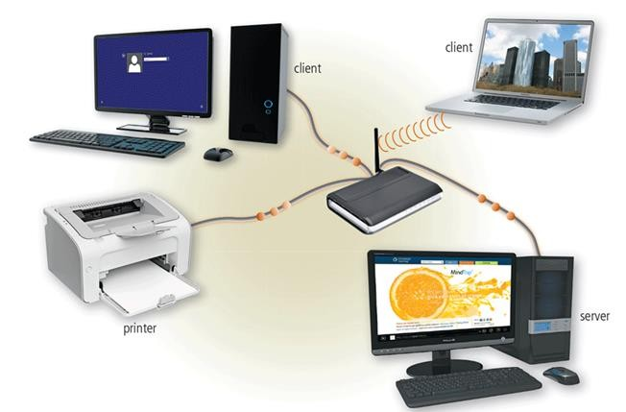
Communications and Networks (6 of 8)
A network is a collection of computers and devices connected together, often wirelessly, via communications devices and transmission media
Figure 1-33 A server manages the resources on a network, and clients access the resources on the server. This network enables three separate computers to share the same printer, one wirelessly.

Slide 57
Communications and Networks (7 of 8)
Home Networks
Connect to the Internet
Share a single high-speed Internet connection
Access photos, music, videos, and other content
Share devices
Play multiplayer games
Connect game consoles to the Internet
Subscribe to and use VoIP
Interact with other devices in a smart home

Slide 58
Communications and Networks (8 of 8)
Business Networks
Facilitate communications
Share hardware
Share data, information, and software

Slide 59
Computer Applications in Society
Education
Government
Finance
Retail
Entertainment
Health Care
Science
Travel
Publishing
Manufacturing

Slide 60
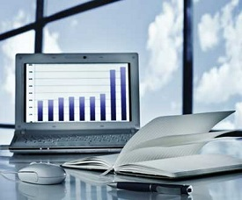
Business
A computer has high speed of calculation, diligence, accuracy, reliability, or versatility which has made it an integrated part in all business organizations.
Computer is used in business organizations for −
Payroll calculations
Budgeting
Sales analysis
Financial forecasting
Managing employee database
Maintenance of stocks, etc.

Slide 61
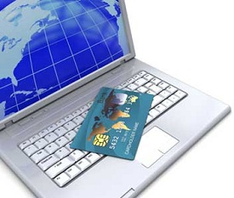
Banking
Today, banking is almost totally dependent on computers.
Banks provide the following facilities −
Online accounting facility, which includes checking current balance,
making deposits and overdrafts, checking interest charges, shares,
and trustee records.
ATM machines which are completely automated are making it even
easier for customers to deal with banks.

Slide 62
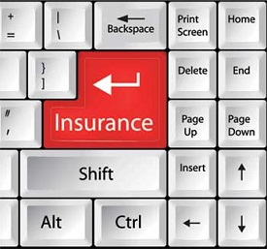
Insurance
Insurance companies are keeping all records up-to-date with the help of computers. Insurance companies, finance houses, and stock broking firms are widely using computers for their concerns.
Insurance companies are maintaining a database of all clients with information showing −
Procedure to continue with policies
Starting date of the policies
Next due installment of a policy
Maturity date
Interests due
Survival benefits
Bonus

Slide 63

Education
The computer helps in providing a lot of facilities in the education system.
The computer provides a tool in the education system known as CBE (Computer Based Education).
CBE involves control, delivery, and evaluation of learning.
Computer education is rapidly increasing the graph of number of computer students.
There are a number of methods in which educational institutions can use a computer to educate the students.
It is used to prepare a database about performance of a student and analysis is carried out on this basis.

Slide 64
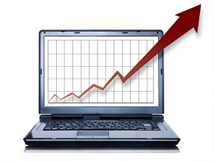
Marketing
In marketing, uses of the computer are following −
Advertising − With computers, advertising professionals create art and graphics, write and revise copy, and print and disseminate ads with the goal of selling more products.
Home Shopping − Home shopping has been made possible through the use of computerized catalogues that provide access to product information and permit direct entry of orders to be filled by the customers.

Slide 65

Healthcare
Computers have become an important part in hospitals, labs, and dispensaries. They are being used in hospitals to keep the record of patients and medicines. It is also used in scanning and diagnosing different diseases. ECG, EEG, ultrasounds and CT scans, etc. are also done by computerized machines.
Following are some major fields of health care in which computers are used.
Diagnostic System − Computers are used to collect data and identify the cause of illness.
Lab-diagnostic System − All tests can be done and the reports are prepared by computer.
Patient Monitoring System − These are used to check the patient's signs for abnormality such as in Cardiac Arrest, ECG, etc.
Pharma Information System − Computer is used to check drug labels, expiry dates, harmful side effects, etc.
Surgery − Nowadays, computers are also used in performing surgery.

Slide 66
Engineering Design
Computers are widely used for Engineering purpose.
One of the major areas is CAD (Computer Aided Design) that provides creation and modification of images. Some of the fields are −
Structural Engineering − Requires stress and strain analysis for design of ships, buildings, budgets, airplanes, etc.
Industrial Engineering − Computers deal with design, implementation, and improvement of integrated systems of people, materials, and equipment.
Architectural Engineering − Computers help in planning towns, designing buildings, determining a range of buildings on a site using both 2D and 3D drawings.
Structural Engineering − Requires stress and strain analysis for design of ships, buildings, budgets, airplanes, etc.
Industrial Engineering − Computers deal with design, implementation, and improvement of integrated systems of people, materials, and equipment.
Architectural Engineering − Computers help in planning towns, designing buildings, determining a range of buildings on a site using both 2D and 3D drawings.

Slide 67
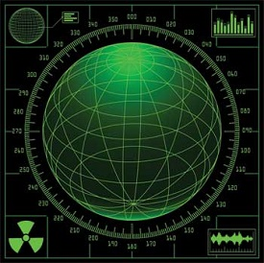
Military
Computers are largely used in defense. Modern tanks, missiles, weapons, etc. Military also employs computerized control systems. Some military areas where a computer has been used are −
Missile Control
Military Communication
Military Operation and Planning
Smart Weapons

Slide 68
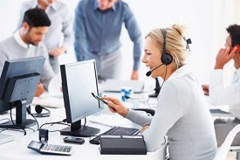
Communication
E-mail
Chatting
Usenet
FTP
Telnet
Video-conferencing

Slide 69

Government
Computers play an important role in government services. Some major fields in this category are −
Budgets
Sales tax department
Income tax department
Computation of male/female ratio
Computerization of voters lists
Computerization of Permanent account number(PAN) card
Weather forecasting

Slide 70
Summary
Basic computer concepts
Various methods for input, output, memory, and storage
The Internet
Digital security and safety risks and precautions
Uses of technology applications in society

